Slide 1
Tools from CBT for Anxiety & Time Management
SURAYA KEATING, MFT, EMDR Certified Therapist
Registered Expressive Arts Therapist, Drama Therapist
www.suraya.org

Slide 2
ser
WHAT IS COGNITIVE BEHAVIORAL THERAPY (CBT)?

Slide 4
“There are only two things we can control in life: our actions and our attitudes.” - Unknown

Slide 5
Key Concepts of the CBT Triad
OUR THOUGHTS (thoughts congealed become an ATTITUDE) influence our FEELINGS & BEHAVIORS.
OUR BEHAVIORS (aka ACTIONS) influence our FEELINGS & THOUGHTS.
OUR FEELINGS influence our THOUGHTS/ATTITUDES as well as our BEHAVIORS/ACTIONS.

Slide 6
FEELINGS
ATTITUDES/THOUGHTS
ACTIONS/BEHAVIORS

Slide 7
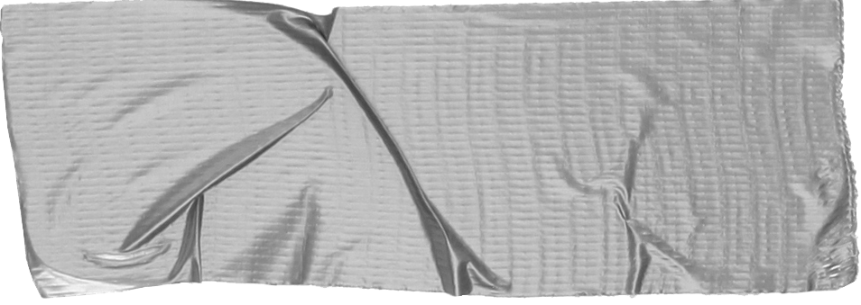
Tool #1: Self-kindness practice
When you experience a challenging feeling, related to anxiety/time management, try the following self-kindness practice:
Pause, take 3 deep breaths.
Place a hand on your belly and a hand on your heart.
As you breath, say to yourself: “I love you so much. I know it’s hard right now. I’m with you.”
Ask yourself: “What would give me some relief?”

Slide 8
ser
“Between the stimulus and response, there is a space, and in that space lies our power and freedom.” - Victor Frankl

Slide 9
TOOL #2 AWARENESS TRIANGLES
INSTRUCTIONS
Draw or cut out a TRIANGLE
At the top of the triangle, write the feeling that is troubling you.
On the bottom left, brainstorm those attitudes/thoughts that feed the troubling feeling (i.e., make it worse).
On the bottom right, brainstorm actions/behaviors that make the troubling feeling worse.

Slide 10
CHALLENGING FEELING: E.g, Anxious, unfocused, etc.
ATTITUDES that feed anxiety, lack of focus, etc.
ACTIONS that feed anxiety, etc.

Slide 11
TOOL #3. EMPOWERMENT TRIANGLES
INSTRUCTIONS
Draw or cut out a TRIANGLE
At the top of the triangle, write the feeling that is troubling you.
On the bottom left, brainstorm those attitudes/thoughts that feed the troubling feeling (i.e., make it worse).
On the bottom right, brainstorm actions/behaviors that make the troubling feeling worse.

Slide 12
HOW YOU WANT TO FEEL: E.g, Easeful, focused, etc.
ATTITUDES that support how you want to feel
ACTIONS that support how you want to feel

Slide 13
3. STEP THREE
VISUALIZE A MINOR STRESSOR. Notice what happens when you think of the minor stressor in contrast to what happens when you think of your safe, calm place combined with BLS.
THINK OF the minor stressor.
Say the TITLE of your safe calm place, think of it, and begin BLS.

Slide 14
FINAL PRACTICE FOR THE ROAD OF LIFE:
CHOOSE 1 HELPFUL ATTIUDE & 1 HELPFUL ACTION
MY ACTION:
MY ATTITUDE:

