Slide 1
Indigenous Intergenerational Housing Practices and Emotional Safety
Skye K. Innerarity, LMFT #104388
(She/Her)

Slide 2
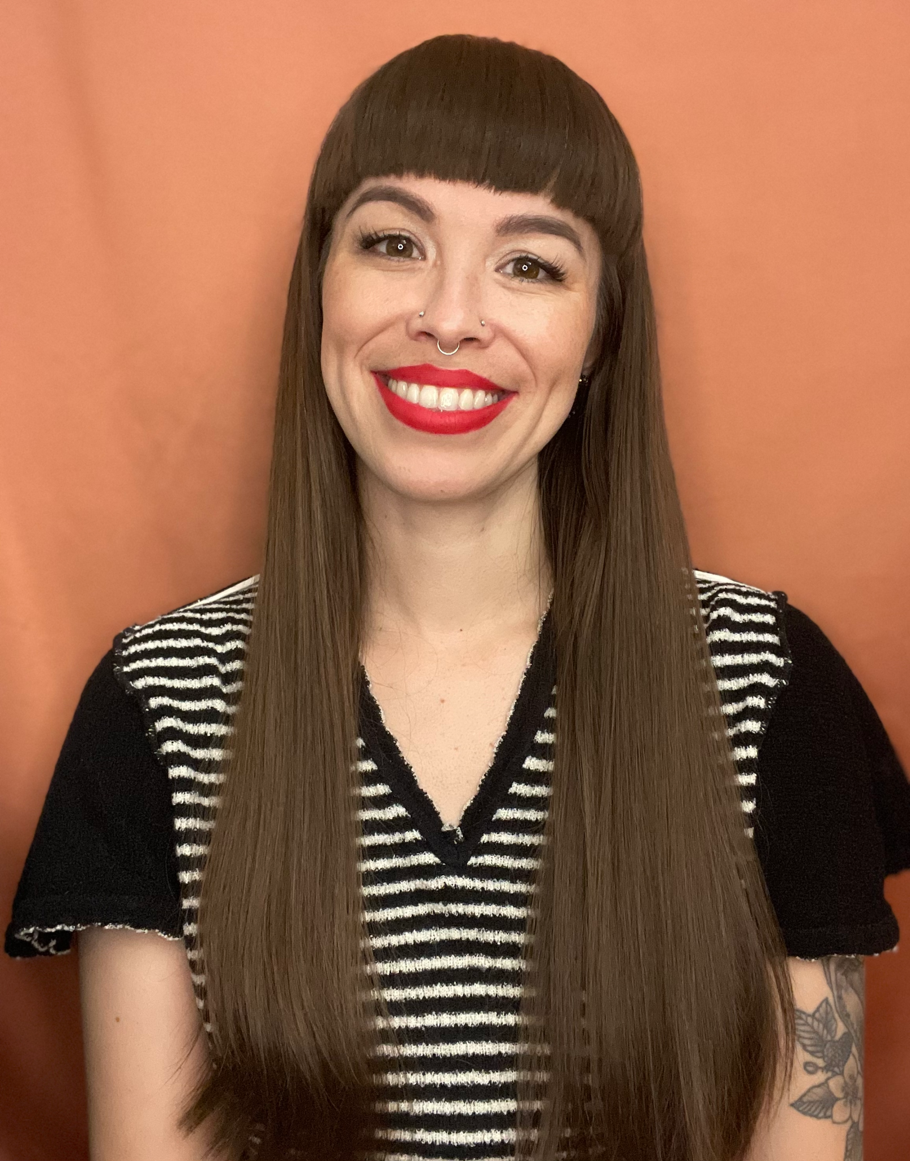
Skye is a Licensed Marriage and Family Therapist with an established private practice in Sacramento, CA, where she utilizes a genuinely warm, humorous, and direct approach to gently challenge clients and invite them to step out of their current comfort zone and step into authentic living. She advocates for culturally conscious and meaningful practices and ways of being (e.g. language revitalization, basketweaving, ceremonial practices, song and dance, traditional tattooing and piercing, etc.) as a way to actively address mental health concerns in Indigenous communities. As a Northern Sierra Miwok woman and citizen of the Ione Band of Miwok Indians, Skye intimately understands the impact of intergenerational trauma and she also understands the profound impact of clinically holding and protecting space for others to name, process, and explore their own survivance in order to further facilitate healing and growth. It is through this intersection of academic, personal, and professional experiences that Skye strives to strategically and insightfully contribute her learned and lived knowledges to her community and the individual and collective healing work ahead.

Slide 3
Learning Objectives
Utilizing the concept of Indigenous praxis, we will explore how Indigenous intergenerational housing practices promote value-guided living on the individual level and the community level alike.
Together we will explore examples of Northern Sierra Miwok intergenerational housing practices, specifically what they look and feel like.
We will identify how Indigenous intergenerational housing practices promote emotional safety via cultural transmission of knowledges and experiences, where people can be seen, heard, and held in softness.
Finally, we will discuss how both non-Indigenous folks and Indigenous folks can acknowledge, support, and normalize Indigenous intergenerational housing practices.

Slide 4
Indigenous Praxis
Value-guided
Community-informed
Land-based

Slide 5
Examples of Northern Sierra Miwok
Intergenerational Housing Practices
Living with Aunties, Uncles, Grandparents, Great Grandparents, Cousins, etc. in addition to or without parents and siblings
Looks and feels like… busy, loud, people coming and going, shared meals, group activities and gatherings, limited privacy
Anyone in home can fulfill parenting/caretaking roles
Looks and feels like… flexible roles and practices
Embedded transmission of cultural knowledge and practices
Looks and feels like… Day-to-day interactions where Elders learn from those younger than them, younger folks “catch stories” and learn thoughts/feelings/beliefs behind cultural practices

Slide 6
Benefits of Northern Sierra Miwok
Intergenerational Housing Practices
Examples of Practices | Individual Benefits | Community Benefits
Living with Aunties, Uncles, Grandparents, Great Grandparents, Cousins, etc. in addition to or without parents and siblings Going to college and living with family | Development and strengthening of emotional self-assessment skills, communication skills, and boundary setting | Increased openness and willingness to talk about difficult topics and situations Specific relatives known for specialized skills and knowledges
Anyone in home can fulfill parenting/caretaking roles Great Grandparents taking care of Great Granddaughter Mother taking care of Great Grandma | Needs are met or exceeded | Increased accountability and responsibility for self and others

Slide 7
How can Indigenous intergenerational housing practices promote emotional safety via cultural transmission of knowledges and experiences, where people can be seen, heard, and held in softness?
Indigenous housing practices give people day-to-day opportunities to assess for emotional safety and opportunities to act on emotional safety by authentically opening up to gift/receive cultural knowledges (information and skills) and experiences (stories).

Slide 8
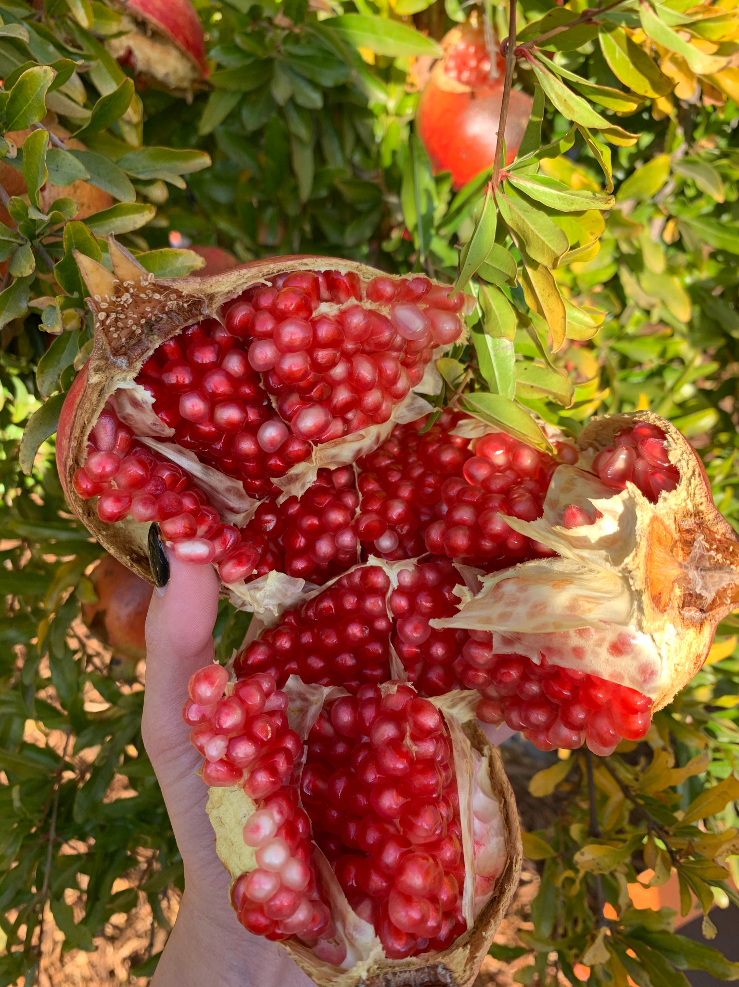
Summary
Indigenous intergenerational housing practices are Value-guided,
Community-informed, and
Land-based and promote a more equitable environment where everyone has a purpose, an opportunity to contribute/feel needed and wanted, and an opportunity to experience both individual and community emotional safety via cultural transmission of knowledges and experiences.

Slide 9
Highlights & Takeaways
How can the rest of the community (non-Indigenous folks) acknowledge, support, and normalize Indigenous intergenerational housing practices?
Remember that Indigenous intergenerational housing practices promote connection in context (to ancestors, living relatives, future generations, time, place, space, and “other-than-human relations” like plants and animals)!
When in doubt, be compassionately curious and ask questions! (e.g. “What does the word ‘privacy’ mean to you?;” “What does a ‘busy day’ look and sound like in your house?”
Consider your own intergenerational housing practices and what they mean to you. How do they relate/not relate to Indigenous identities and practices?

Slide 10
Learning Objectives
Utilizing the concept of Indigenous praxis, we explored how Indigenous intergenerational housing practices promote value-guided living on the individual level and the community level alike.
Together we explored examples of Northern Sierra Miwok intergenerational housing practices, specifically what they look and feel like.
We identified how Indigenous intergenerational housing practices promote emotional safety via cultural transmission of knowledges and experiences, where people can be seen, heard, and held in softness.
Finally, we discussed how both non-Indigenous folks and Indigenous folks can acknowledge, support, and normalize Indigenous intergenerational housing practices.

Slide 11
Skye is a Licensed Marriage and Family Therapist with an established private practice in Sacramento, CA, where she utilizes a genuinely warm, humorous, and direct approach to gently challenge clients and invite them to step out of their current comfort zone and step into authentic living. She advocates for culturally conscious and meaningful practices and ways of being (e.g. language revitalization, basketweaving, ceremonial practices, song and dance, traditional tattooing and piercing, etc.) as a way to actively address mental health concerns in Indigenous communities. As a Northern Sierra Miwok woman and citizen of the Ione Band of Miwok Indians, Skye intimately understands the impact of intergenerational trauma and she also understands the profound impact of clinically holding and protecting space for others to name, process, and explore their own survivance in order to further facilitate healing and growth. It is through this intersection of academic, personal, and professional experiences that Skye strives to strategically and insightfully contribute her learned and lived knowledges to her community and the individual and collective healing work ahead.

Slide 12
Indigenous Intergenerational Housing Practices and Emotional Safety
Skye K. Innerarity, LMFT #104388
(She/Her)

