Slide 1
Health Care for the Homeless
Co-Applicant Governing Board
Welcome
Wednesday, January 18th, 2023, 11:00-12:30pm
Board Member & Public
Attendee Introductions

Slide 2
Health Care for the Homeless
Co-Applicant Governing Board
Action ITEM:
Request for Approval
December Meeting Minutes
Stephen Krank, HCH Board Chair
Attachments: December Meeting Minutes

Slide 3
Health Care for the Homeless
Co-Applicant Governing Board
Standing ITEM:
HCH Services Update
Heather Cedermaz, HCH Lead Provider & Mia Fairbanks, HCH Nurse manager

Slide 4
Health Care for the Homeless
Co-Applicant Governing Board
Board Member Recruitment & Training
all

Slide 5
Board Composition
Current Board Representation
Board & County Demographics
Independent Living Resources
Past CCHS Public Health Director
CORE
City of Antioch
Hope Solutions
SVDP
Finance Executive
Kaiser
BACS

Slide 6
Recruitment & Training
New Member Application
Trainings

Slide 7
Health Care for the Homeless
Co-Applicant Governing Board
Standing ITEM:
Quality improvement/ assurance
Gabriella Quintana, HCH QI Team

Slide 8
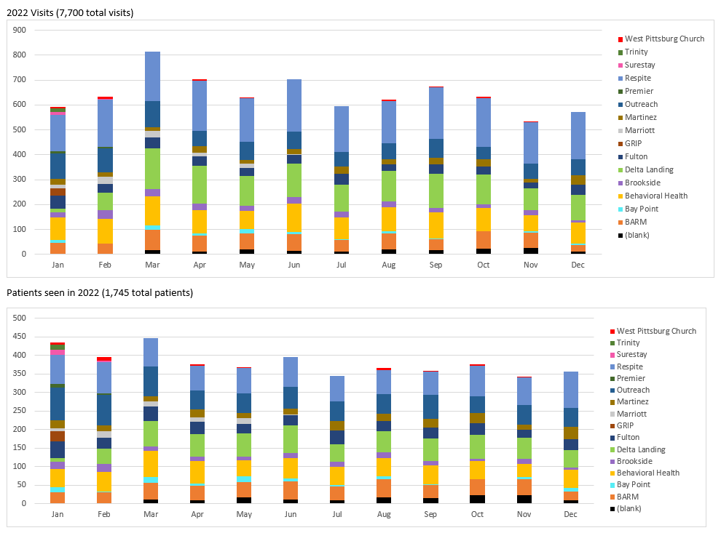
Productivity
Total Patients Seen Over Time:
2017- 2,146
2018- 2,469
2019- 2,370
2020- 2,001
2021- 1,653
Total Visits Over Time:
2017- 6,486
2018- 8,798
2019- 8,821
2020- 8,309
2021- 7,291

Slide 9
2023 Priorities
One change in phrasing from 2022 on Priority #2
  2022: Assess patients' social determinants of health needs upon enrollment in Compass Rose.
  2023: Improve the understanding of patient mental health needs and ensuring better access and connection to care.
Reasoning:
  Better aligns with the associated measures.
  Moves away from relying on Compass Rose which is not yet fine tuned.

Slide 10
Health Care for the Homeless
Co-Applicant Governing Board
Standing ITEM:
Field Trips
all

Slide 11
Health Care for the Homeless
Co-Applicant Governing Board
Standing ITEM:
Community Updates
all

Slide 12
Future Matters
PD Evaluation
UDS Data

Slide 13
HCH Co-Applicant Governing Board
Next Meeting
Wednesday, February 15, 2023
11:00 – 12:30pm
Zoom Conference Call

