Slide 1
Independent Investigation of PBF Energy Martinez Refinery Catalyst Release Incident, November 24-25, 2022
Scott Berger and Associates, LLC
Investigation Update February 1, 2024

Slide 2
Our Team
Tim Mullowney
Petrochor
Founder Petrochor
35 years’ broad refinery experience
Operated Catalytic Cracking Units
Process Safety leader for major refining company
Many refinery investigations, including of Catalytic Cracking Units
Scott Berger
Scott Berger and Associates, LLC
Bachelors/Masters Chemical Engineering, Massachusetts Institute of Technology
45 years’ total experience
14 years as Executive Director, Center for Chemical Process Safety
8 years as Independent Consultant
CCPS Certified Process Safety Professional
CCPS Fellow, AIChE Fellow

Slide 3
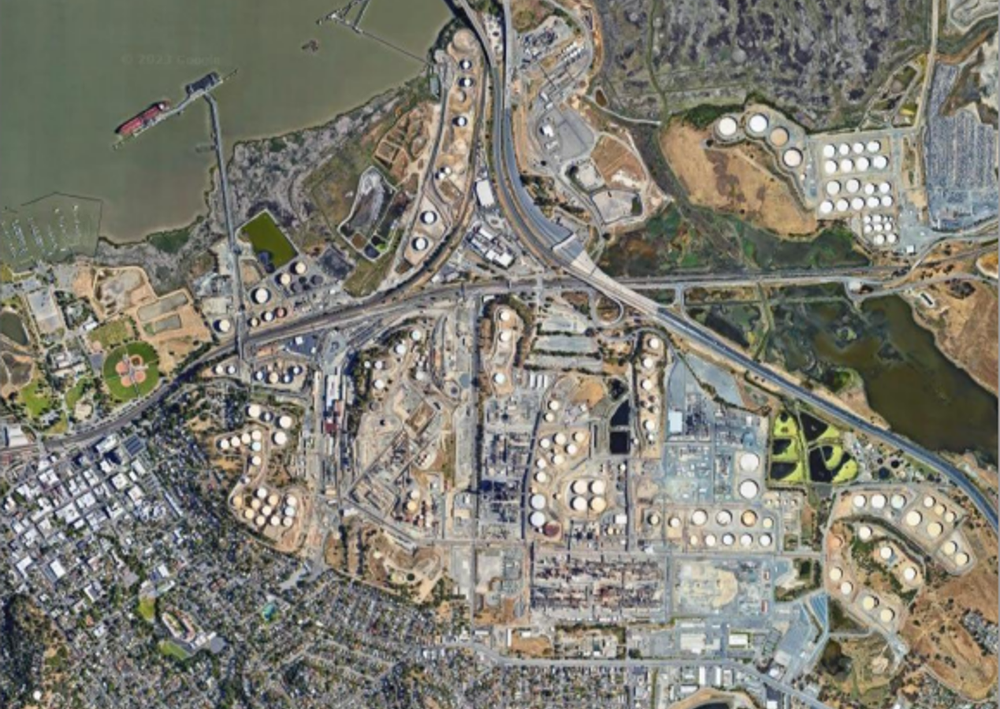
Project Background
Spent catalyst dust released on November 24, 2022 from Catalytic Cracking Unit at PBF Martinez Refinery
Physical evidence of release observed and reported by community members as white powder deposited on surfaces
CCHHMP contracted Scott Berger and Associates to perform an independent root cause analysis of the release
Eight root causes identified addressing how PBF:
Assessed risk of catalyst release
Prepares procedures and follows them
Trains Catalytic Cracking Unit personnel
Empowers employees to stop or pause work in unsafe situations or when things aren’t going as expected
Manages worker fatigue

Slide 4
Overview of Presentation
Objectives and approach
Overview of catalytic cracking
Evolution of the incident
Root causes and recommendations
Discussion of wet gas scrubbers vs electrostatic precipitators
Evaluation of PBF Martinez Refinery Major Chemical Accident Investigation Report

Slide 5
Objectives and Approach
Approach:
Reviewed PBF Martinez documents and data
Interviewed key personnel
Identified root causes = gaps in process safety management systems
Evaluated contributing causes
Made recommendations to address

Slide 6
Overview of Catalytic Cracking Purpose: “Crack” larger hydrocarbon molecules into smaller ones
3rd stage separator and Regenerator Pressure Control
Stripper slide valve
1st and 2nd stage cyclones
Overhead accumulator and Wet Gas Compressor: Reactor pressure control
Stripper
Reactor
Regenerator
To CO Boilers, Electrostatic precipitators, and stack
Main Fractionator
Additional product processing
Flare system
4th stage separator
Regenerator slide valve
Manual drain of spent catalyst
Feed
Regenerated catalyst
Air Compressor and Heater
Air

Slide 7
Evolution of the Incident November 21, 2022: air controller failed, cracker shut down
3rd stage separator and Regenerator Pressure Control
Stripper slide valve
1st and 2nd stage cyclones
Propane
Overhead accumulator and Wet Gas Compressor: Reactor pressure control
Stripper
Reactor
Regenerator
To CO Boilers, Electrostatic precipitators, and stack
X
Main Fractionator
Additional product processing
4th stage separator
Regenerator slide valve
Manual drain of spent catalyst
Feed
X
Regenerated catalyst
Air Compressor and Heater
X
Air

Slide 8
Evolution of Incident
Electrostatic Precipitator De-Energized – A Critical Safety Measure
February 18, 2015
ExxonMobil catalytic cracker at Torrance, CA refinery shut down
Electrostatic precipitators remained energized
Hydrocarbon leaked to the electrostatic precipitators, ignited with electrostatic spark, and exploded
Based on this incident, refineries now de-energize electrostatic precipitators when their catalytic crackers shutdown, and during re-start

Slide 9
Evolution of Incident Efforts to restart, November 21-24
11/21/22
11/22/22
11/23/22
11/24/22
Key employee “A” began period of excessive work hours leading up to incident
Failed air system component replaced
Difficulties in re-lighting air preheater
Restart began; established hot catalyst recirculation

Slide 10
Evolution of Incident Morning of November 24, 2022
Propane
Overhead accumulator and Wet Gas Compressor: Reactor pressure control
Stripper
Stripper slide valve
Reactor
Engineer told day shift operators:
Don’t reintroduce feed unless stripper slide valve in automatic
If stripper slide valve can’t be run in automatic, call instrument tech
First flaring event: Compressed gas plant vented to flare system
Main Fractionator
Additional product processing
Flare system
Regenerator slide valve
Feed
X
Regenerated catalyst

Slide 11
Evolution of Incident: Reintroduction of feed
Stripper slide valve not in automatic when feed reintroduced, remained manually controlled
Started feed flow A to reactor little-by-little while closing feed bypass B
With initial feed, reactor pressure surged
Second flaring event: Overhead accumulator vented to flare
Refinery logistics notified catalytic cracking that propane inventory approaching minimum
Key employee “A” instructed colleagues “No flaring, use no additional propane
Propane
Overhead accumulator and Wet Gas Compressor: Reactor pressure control
Stripper
Stripper slide valve
Reactor
Main Fractionator
Additional product processing
Flare system
Regenerator slide valve
B
Feed
A
Regenerated catalyst

Slide 12
Evolution of the Incident: The Incident Begins ~8:30 PM
Regenerator to high-level. Cyclones choked; catalyst filled 4th stage separator and vented from CO Boiler stacks
Stripper slide valve not closed down fast enough in manual. Catalyst flowed rapidly from Stripper to Regenerator
Increased reaction drove up reactor pressure
3rd stage separator and Regenerator Pressure Control
Stripper slide valve
1st and 2nd stage cyclones
Propane
Overhead accumulator and Wet Gas Compressor: Reactor pressure control
Stripper
Regenerator
Reactor
Regenerator
To CO Boilers, Electrostatic precipitators, and stack
X
Main Fractionator
Additional product processing
4th stage separator
Regenerator slide valve
Manual drain of spent catalyst
B
Feed
A
Regenerated catalyst
Increased feed to reactor: A more open, B more closed
Air Compressor and Heater
Air
Notes:
Before presentation, dark red regenerator will be moved directly over light red

Slide 13
Personnel Did Not Recognize Release Was Occurring
Didn’t associate a high-high level in the 4th stage separator with a potential release
Stack opacity meter was already at its highest reading
No catalyst observed falling inside refinery
Calls from community were received only after daylight November 25

Slide 14
Evolution of the Incident: Incident Continues
8:30 PM 11/24/22
11:30 PM
11/24/22
4:30 AM
11/25/22
6:15 AM
11/25/22
Operators continued to increase feed rate to reactor
Stripper slide valve remained in manual
4th stage separator at high-high despite continual efforts to drain
Period of highest catalyst release rate
Period of lower catalyst release rate
High opacity
Normal opacity
Full rate, start-up completed

Slide 15
Simplified Causal Tree WITH ROOT CAUSES
High level in Regenerator leading to catalyst release
Inadequate safeguards
High catalyst flow from Stripper to Regenerator
Process hazard analysis underestimated severity of potential incident
Stripper slide valve in Manual
Operator response not aggressive enough
Procedure not followed
1. Inadequate process hazard analysis guidance re: catalyst release
Fatigue
8. Gap in site fatigue management system
Six additional root causes with culture implications (next slide)
Operator error not a root cause

Slide 16
Additional Root Causes With Culture Implications
Procedures: Practice of deviating from procedures without managing field changes
Stop work authority: Practice of not pausing to reevaluate work when things go differently than expected
Procedures: Operating procedure management system failed to ensure cautionary statements were adequate
Training: Required “Just-in-time” training prior to start-up not done
Training: Operator training did not address rationale for alarms that signaled potential catalyst release
Training: Operator training did not address instrument failure modes, troubleshooting, and when to call instrument technician

Slide 17
Contributing Factors May have contributed to incident but were not strictly root causes
Distractions that occupied operators’ attention, potentially slowing or delaying manual adjustments to stripper slide valve:
E.g., directive to not flare and not to draw additional propane
Engineering designs not present in PBF Martinez but common to other refineries’ catalytic cracking units that may have helped avoid incident:
Advanced control of Reactor - Regenerator differential pressure
Direct measurement of feed flowing into Reactor (during feed reintroduction)

Slide 18
Pros and Cons: What if PBF Martinez had used a wet scrubber instead of an electrostatic precipitator for final treatment of catalytic cracking unit emissions?
Pros:
Would have been able to remain operating during catalytic cracker shutdown and restart
Opacity exceedance between 11/21 and 11/23 would likely have been avoided
In the early phase of the catalyst release on 11/24, would have prevented some of the release
Cons:
After the early phase of catalyst release, solids removal capability in the water recycle loop would have been quickly exceeded
Would likely have caused a wet gas scrubber to shut down before release was over
Total catalyst release would have been reduced only somewhat
During normal operation, hot air flowing through scrubber evaporates water
A large consumer of water
Discharge additional moisture to atmosphere
Conclusion: While use of a wet gas scrubber would probably have prevented the high opacity condition before the incident, it would not have reduced the incident severity significantly. Therefore, this was neither a root cause nor a contributing factor in this incident.

Slide 19
Recommendations From This Investigation
Root Cause: Inadequate process hazard analysis guidance re: catalyst release
Clarify corporate guidance regarding environmental catalyst releases
Review relevant refinery process hazard analyses for similar scenarios where environmental release scenarios may be underestimated
Root Cause: Practice of deviating from procedures without managing field changes
Review and revise site procedures for managing field changes to ensure means for promptly reviewing and approving field changes are addressed; affected personnel are trained on this procedure; that metrics allowing management oversight are provided

Slide 20
Recommendations From This Investigation - Continued
Root Cause: Practice of not pausing to reevaluate work when things go differently than expected (stop work authority)
Add consideration of situational factors to pre-startup safety review instructions in refinery procedures involving start-up
Update stop-work policy/program and associated training to include evaluation of complex situations in non-routine work
Root Cause: Operating procedure management system failed to ensure cautionary statements were adequate
In procedure development system, revise procedure development checklist to ensure that cautionary statements are included when appropriate
Update catalyst cracking procedure 1110 to include a caution statement explaining rationale for ensuring Stripper Slide Valve is in automatic before reintroducing feed to the Reactor

Slide 21
Recommendations From This Investigation - Continued
Root Cause: Required “Just-in-time” training prior to start-up not done
Modify training management system to ensure that “just-in-time” training for catalytic cracker procedure CCU-1110 and other relevant procedures is conducted as prescribed in catalytic cracker console operator training workbook
Root Cause: Operator training did not address rationale for alarms that signaled potential catalyst release
Develop or update criteria for operator training and conduct review of training materials to ensure the basis for all alarms used as safeguards are included in training materials

Slide 22
Recommendations From This Investigation - Continued
Root Cause: Operator training did not address instrument failure modes, troubleshooting, and when to call instrument technician
Standardize approach for response to malfunctioning instrumentation and educate affected personnel. Address failure modes of instruments, when to ask for instrument technician. Reference refinery program for bypassing safety devices.
Root Cause: Gap in site fatigue management system
Modify fatigue policy to include both all hourly and all salaried personnel performing safety-sensitive activities
Educate affected individuals who weren’t previously covered by the policy
Provide refinery leadership oversight of fatigue policy, supported by relevant metrics

Slide 23
Recommendations From This Investigation - Continued
Contributing Cause: Personnel had difficulty managing the differential pressure between the Reactor and the Regenerator during Catalyst Cracking Unit startup
Consider upgrading the control scheme of Reactor/Regenerator differential pressure to Cascade control of Regenerator pressure setpoint (based on Reactor pressure)
Contributing Cause: Lack of flow indication of feed to the Reactor increased the difficulty of managing the reactor pressure/wet gas compressor suction pressure and stripper slide valve differential pressure
Consider adding a flow meter to inform operators of actual feed flow rate to Reactor

Slide 24
Evaluation of PBF Martinez Public Investigation Report: Causes
Cause | Summary of PBF Martinez finding | Comparison to this independent investigation
Root cause 1 | Inadequate manual adjustment of Regenerator pressure control | A contributing factor but not a root cause
Root cause 2 | Inadequate manual adjustment of Stripper slide valve | This root cause blames the worker. This investigation found six procedure/training-related root causes
Contributing factor | Curtailment of propane to the Wet Gas Compressor | This was an added distraction to operators, and therefore a contributing cause, but Wet Gas Compressor did not require additional propane
Human factor 1 | Deviation from fatigue policy | As written, blames the worker. This investigation found a root cause related to PBF Martinez fatigue management policy and oversight thereof
Human factor 2 | Not completing end-of-shift reports reliably | This investigation did not find a causal link. However, not completing this important task could represent a culture issue

Slide 25
Evaluation of PBF Martinez Public Investigation Report: PBF’s Corrective Measures
PBF Corrective Action | Status | Comparison to Independent investigation
1. Determine control strategy to automate reactor/regenerator differential pressure | Strategy developed; Shell had intended to implement at 2018 turnaround but did not. Implementation now intended for 2025 turn-around | A contributing cause, with same recommendation
2. Provide additional alarm guidance for this scenario | Complete | Broader recommendations regarding procedures, training, and alarm guidance
3. Develop additional operator training on maintaining reactor/regenerator differential pressure and catalyst bed level | Training was developed and in progress in November 2023 | Broader recommendations regarding training, but more importantly the need to follow procedures as written or modify them through a formal process
4. Modify procedure CCU-1110 to provide additional instructions on when to put Stripper Slide valve in Auto | Complete | Broader recommendations regarding reinforcing need to follow procedures and to provide appropriate cautionary statements

Slide 26
Evaluation of PBF Martinez Public Investigation Report: PBF’s Corrective Measures (Continued)
PBF Corrective Action | Status | Comparison to Independent investigation
5. Evaluate options to increase molecular weight of gas to wet gas compressor during feed-reintroduction | An option to use butane instead of propane is in the engineering stage | The availability of propane was not found to be a root cause, instead a contributing factor/distraction.
6. Reiterate to personnel the expectations and requirements of the refinery fatigue policy | Complete | Deeper recommendation for management to monitor and enforce fatigue policy
7. Reiterate to personnel the expectations and requirements to complete end-of-shift reports | Complete | Not found to be a root or contributing cause, nonetheless a sound action item
8. Provide additional tools to increase effectiveness of staff work schedules and fatigue management | Complete | Same as #6. Tools must be used regularly by refinery leadership to ensure compliance with and effectiveness of fatigue policy

Slide 27
Evaluation of PBF Martinez Public Investigation Report: PBF’s Corrective Measures (Continued)
PBF Corrective Action | Status | Comparison to Independent investigation
9. Add indication of 4th stage separator differential pressure to utilities console with appropriate alarm and response guidance. | Complete | Similar to recommendation related to independent investigation root cause 6
10. Update community monitoring procedure to include activation and response for defined opacity events. | Complete | Similar to independent root cause recommendations and 6.
11. Determine if electrostatic precipitators can be safely activated during the CCU start-up process | Complete; industry guidance continues to warn against doing this. | Not a root cause; even if precipitators could be operated safely, they would remove only a fraction of the released catalyst.

Slide 28
Next Steps
Form Oversight Committee
Select and Hire Contractor
Contractor Investigation
Draft Report Presented to Oversight Committee
Presentation to the Board of Supervisors and City Council
Respond to Public Comments
45-Day Public Comment Period with Public Meeting

Slide 29
Your Questions Are Welcome
Scott Berger and Associates, LLC Scott Berger, President
February 1, 2024

